Slide 1


Maximizing Network Optimization, Integrated Business Planning & Commercial Excellence
A U.S – based, multi-billion dollar, vertically integrated, publicly traded heavy manufacturer with manufacturing facilities, warehouses, recycling centers and fabrication shops
The Client:
CASE STUDY:
CLIENT MOVED SIGNIFICANTLY- DISOUNTED STOCK FROM $20 to $45 PER SHARE IN 2.5 YEARs
SUCCESS SNAPSHOT
In late 2020, our client declared intent to optimize their network :
They were in the process of moving from de-centralized to centralized Sales, Inventory, and Operations Planning (S&OP)
They had just put a new Chief Supply Chain Officer in place
They had decided to close one of their largest mills while opening two other mills across the network and needed help transitioning
The planning processes were disparate, ad-hoc, and lacked visibility across the network on sales, production or inventory
There was a large disconnect between the sales organization and operations
The ROIG Group completed a thorough ”remarkability” analysis of the company on the level of delighted customers, strategic & organizational agility, and profitable growth that included a review on whether the company was a REVIVE COMPANY company, an OPTIMIZE COMPANY, an INCUBATE company or a GROW company. It was determined that the company was in an OPTIMIZE state and needed to significantly enhance both SIOP and Commercial Excellence. In ROIG’s analysis of the company, there was a large gap in between sales and operations with the SIOP organization failing to bridge that gap due to its de-centralized operations and ways of working. ROIG identified an ineffective “Adhocracy” with significant gaps to best practices in both the SIOP and Sales organizations.
TOTAL 3-YEAR STRATEGIC
OPPORTUNITY:
$50 million in incremental EBITDA

Slide 2

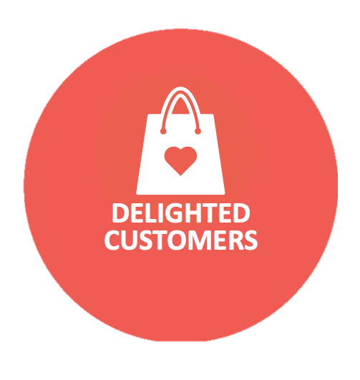
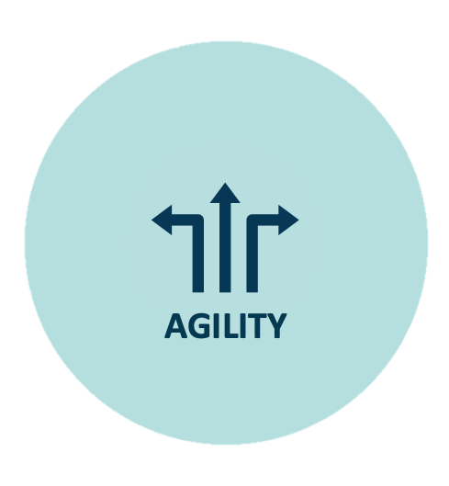
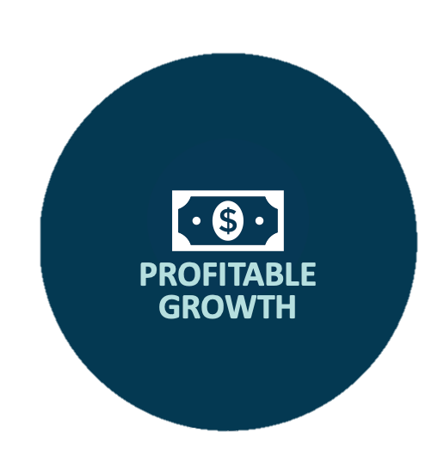
THE STRATEGIC
IMPERATIVES
“We found ourselves speaking in platitudes and bumper speakers before…we are now having the right conversations – more focused and definitely more impactful. We can connect ideas to execution.
Enhance the maturity of the SIOP process
Focus the company on the “metrics that matter” for Network Optimization, SIOP and Commercial Excellence and establish a single version for the truth
Maximize where products were produced vs replenished in order to minimize conversion and logistics costs
Redefine and implement customer segmentation
Establish a business rhythm
- Chief Supply Chain Officer
MOVING FROM PLANNING TO EXECUTION
ROIG worked shoulder-to-shoulder with the client to establish, launch and execute a do-able transformation plan:
1
Created Common Planning Platform
Better connected strategy to planning…and planning to execution
ROIG developed a proprietary planning platform and reporting suite that leveraged the operational data of the client’s ERP. Established weekly, monthly, quarterly, and annual planning rhythms with SIOP, Sales, and Operations
2
Optimized Network
Minimized conversion and logistics costs while improving customer service
ROIG worked to create physical (closing and opening of manufacturing facilities) and logical (identified which customers should be served by which mills)
3
RESULTS
Decision support resulted in savings of $25M in EBITDA within the first year
Enhanced Commercial Excellence
ROIG created a consensus forecast with sales, led product and customer segmentation work, and fundamentally redefined the voice of the customer work
4
Established New SIOP Org Structure
Improved in-stocks by +600 bps while reducing non-stock inventory by 40%
ROIG identified the structure to support the strategy, migrating the company from de-centralized generalists to centralized specialists, establishing new roles and responsibilities including a new Demand Planning capability
On track to realizing $15 - $30m in incremental EBITDA for logical network optimization and improved planning processes
ROAD TO REMARKABLE
Increased in-stocks by $600 bps and implemented a Confidence measurement system
ROIG’s Business Performance Leadership process helps client drive organizational alignment
Lowered logistics and conversion costs by $50M by year 3
For more information, contact The ROIG Group at 612-524-6365 or information@theroiggroup.com

